Slide 1

Diploma Studies
Computer Engineering
Programming Basic Computer
Unit – 3
Title - Programming Basic Computer
Computer Organization (09CE2401)

Slide 2
What is Program ?

Slide 3
What is Program
A program is a list of instructions or statements for directing the computer to perform a required data-processing task.
There are various types of programming languages that one may write for a computer, but the computer can execute programs only when they are represented internally in binary form

Slide 4
Programs written for a computer, categories :
Binary code
Octal or Hex code - Octal numerals can be made from binary numerals by grouping consecutive binary digits into groups of three (starting from the right). A Hexadecimal Number is a positional numeral system with a radix, or base, of 16 and uses sixteen distinct symbols. It may be a combination of alphabets and numbers.

Slide 5
3) Symbolic code - The user employs symbols (letters, numerals, or special characters) for the operation part, the address part, and other parts of the instruction code.
Each symbolic instruction can be translated into one binary coded instruction by an assembler (assembly language program).
4) High Level Language – A high level language is any programming language that enables development of a program in a much more user friendly programming context and is generally independent of the computer’s hardware architecture.

Slide 6
4) High level language - A high level language is any programming language that enables development of a program in a much more user friendly programming context and is generally independent of the computer’s hardware architecture.
However, each statement must be translated into a sequence of binary instructions before the program can be executed in a computer.
The program that translates a high-level language program to binary is called a compiler.

Slide 7
Machine Language
Machine language is a low-level language made up of binary numbers or bits that a computer can understand.
It is also known as machine code or object code and is extremely tough to comprehend.
The only language that the computer understands is machine language.
All programs and programming languages, such as Swift and C++, produce or run programs in machine language before they are run on a computer.
When a specific task, even the smallest process executes, machine language is transported to the system processor.

Slide 8
Machine Language
In the computer, all data like videos, programs, pictures are represented in binary.
The CPU processes this machine code or binary data as input.
Then, an application or operating system gets the resulting output from the CPU and displays it visually.
For example, the ASCII code 01000001 represents the letter "A" in machine language, yet it is shown on the screen as "A".

Slide 9
Machine Language
Different machine code is used by different processor architectures; however, machine code includes 1s and 0s.
For case, as compared to Intel x86 processor that contains a CISC architecture, a PowerPC processor needs different code, which contains a RISC architecture.
For the correct processor architecture, in order to run a program correctly, a compiler must compile high-level source code.

Slide 10
Machine Language
Computer programs are created in one or more programming languages (for example, Java, C++, or Visual Basic).
The program code needs to be compiled through which the computer can understand it, as programming languages used to create computer programs cannot be understand by computer directly.
When the program' s code is compiled, it is converted into.
01001000 01100101 01101100 01101100 01101111 00100000 01010111 01101111 01110010 01101100 01100100

Slide 11
Machine Language - Example
The text "Hello World" would be written in the machine language:
01001000 01100101 01101100 01101100 01101111 00100000 01010111 01101111 01110010 01101100 01100100

Slide 12
Uses of Machine Language
Common uses of machine language are discussed below:
(1) Machine language is a low-level language that machines understand but that humans can decipher using an assembler.
(2) A compiler plays an important role between humans and computers as it converts machine language into other code or language that is understandable by humans.
(3) Assembly language is dedicated to comprehending machine language since it is a rip-off of it.

Slide 13
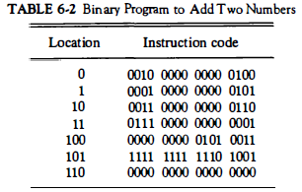
Binary code
This is a sequence of instructions and operands in binary that list the exact representation of instructions as they appear in computer memory.

Slide 14
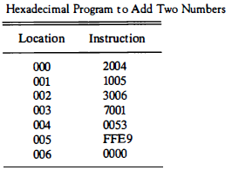
Octal or Hexadecical
equivalent translation of the binary code to octal or hexadecimal representation

Slide 15
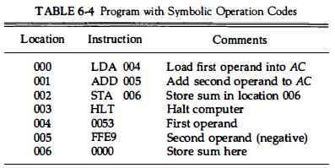
Symbolic Code
The user employs symbols (letters, numerals, or special characters) for the operation part, the address part, and other parts of the instruction code.
Each symbolic instruction can be translated into one binary coded instruction by an assembler.

Slide 16
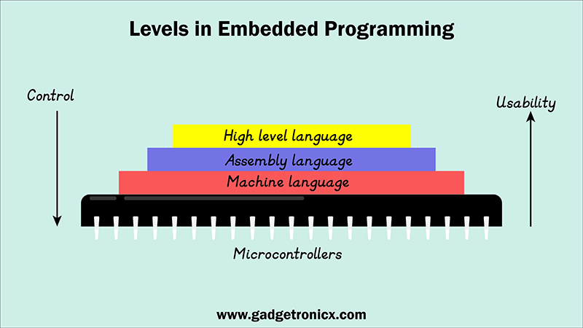

Slide 17
Assembly language
When a programmer uses any high level language such as C, C++, Python this will be first converted into assembly language.
This in a way of saying without assembly language there wouldn’t be any high level languages.
Translated assembly language will be then translated to machine language.
Machine language is the final level in programming languages which a MCU or MPU can understand and operate.
When using Assembly language or ASM, it can be directly translated into machine language.
This translation from Assembly to machine language is done by a special program known as assemblers.

Slide 18
Assembly language
Assembly Language is a low-level programming language.
It helps in understanding the programming language to machine code.
In computers, there is an assembler that helps in converting the assembly code into machine code executable.
Assembly language is designed to understand the instruction and provide it to machine language for further processing.
It mainly depends on the architecture of the system, whether it is the operating system or computer architecture.

Slide 19
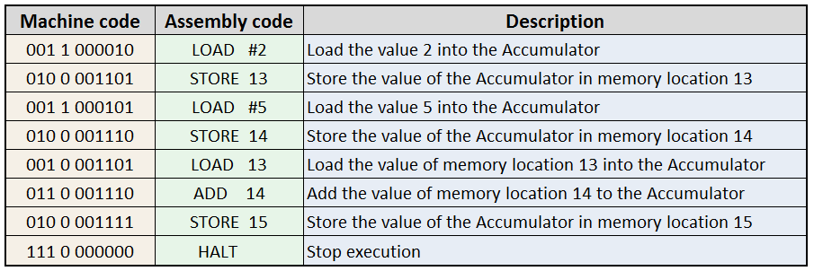
What makes Assembly language special
ASM gives programmer the ability to access the actual registers in the microcontrollers or any target hardware.
It was developed to provide programmer a ease to program microcontrollers and microprocessors.
When you are programming hardware using machine language, you use “0” and “1”s, a lot of them.
Take a look at the below table to visualize how messy machine code can be.

Slide 20
Features of Assembly language
The features of the assembly language are mentioned below:
(1) It can use mnemonic than numeric operation code, and it also provides the information of any error in the code.
(2) This language helps in specifying the symbolic operand that means it does not need to specify the machine address of that operand. It can be represented in the form of a symbol.
(3) The data can be declared by using decimal notation.

Slide 21
Assembly language
Rules of the Language
As we know assembly language program is arranged in three column that are also called as fields which specify following information.
1. Label field - This field may be empty or it may specify symbolic address.
2. Instruction field – It specifies machine instruction or pseudo instruction.
3. Comment field – This field may be empty or it may content comments.

Slide 22
Applications of Assembly language
Assembly language is used for direct hardware manipulation, access to specialized processor instructions, or to address critical performance issues.
Typical uses are device drivers (CD, HDD), low-level embedded systems (Keyboard, water tank indicator) and real-time systems (computer, notepad).

Slide 23
Elements of Assembly language
(1) Mnemonic Operation Code: The mnemonic operation codes for machine instructions are easier to remember and use than numeric operation codes. Example: ADD, SUB, MOVE, etc.
(2) Symbolic Operands: A programmer can associate symbolic names with data or instructions and use these symbolic names as operands in assembly statements. Examples: ADD R1,R2,R3
(3) Data Declaration: Data can be declared in a variety of notations including the decimal notation. Example: NUM1 03 OR NUM1 0011H

Slide 24
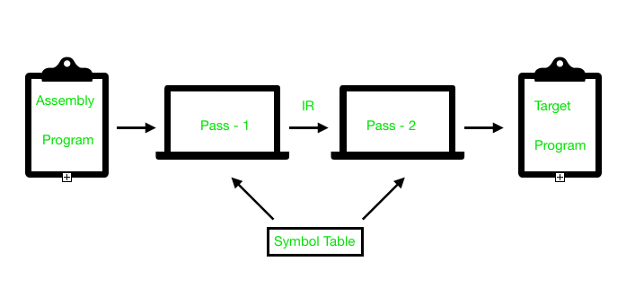
Assembly Process
Convert .asm file into .obj file
(1) Pass 1: Complete scan .asm file. Find all lables, instructions & calculating corresponding address.
(2) Pass 2: Convert all the instruction into machine language format.
(3) Symbol Table: Stored all the information of assembly language data, variables, instructions, address etc.

Slide 25
Assembler
The assemblers are used to translate the assembly language into machine language.
Assembler is a program that accepts a symbolic language program and produces its binary machine language program.
Input program is source program and output we get in result (binary program) is known as object program.
Assembler is responsible for performing translation.
Pseudo instruction are instruction to assembler.

Slide 26
Pseudo Instruction
Symbol | Information for the Assembler
ORG N | Origin means starting of the program
END | END means ending of the program
DEC N | Decimal Number to be converted into binary number
HEX N | Hexadecimal number is converted into binary number
Assembler takes two passes over the source code.
In other words assembler will scan our program twice (first pass and Second pass).

Slide 27
Assembler – First pass of Assembler
First Pass
LC ← 0
Scan next line of code
Set LC
Yes
Label
No
ORG
No
Yes
Store address in symbol table together with value of LC
END
Yes
No
Go to second pass
Increment LC

Slide 28
Assembler – First pass of Assembler
When assembler scan our program first time it does not do any translation.
During the first pass it generate table of all the symbols with binary equivalent value.
As shown in the flowchart the location counter(LC) will have memory address of our program, it can also be called as the control of our program initialization.
STEP-1: location counter is initialize
STEP-2: It scan the line check if label.
STEP-3: if label found store symbol in symbol table.
After store the symbol increment LC and go to Step-2.
if not then check whether it is pseudo instruction.
1. ORG –set LC
2. if END then go to second pass
3. if NO pseudo instruction increment the LC

Slide 29
Assembler – Second pass of Assembler
An assembler is a translator, that translates an assembler program into a conventional machine language program.
Basically, the assembler goes through the program one line at a time and generates machine code for that instruction.
Let us see two-pass assemblers.
Then the assembler processes to the next instruction.
In this way, the entire machine code program is created.

Slide 30
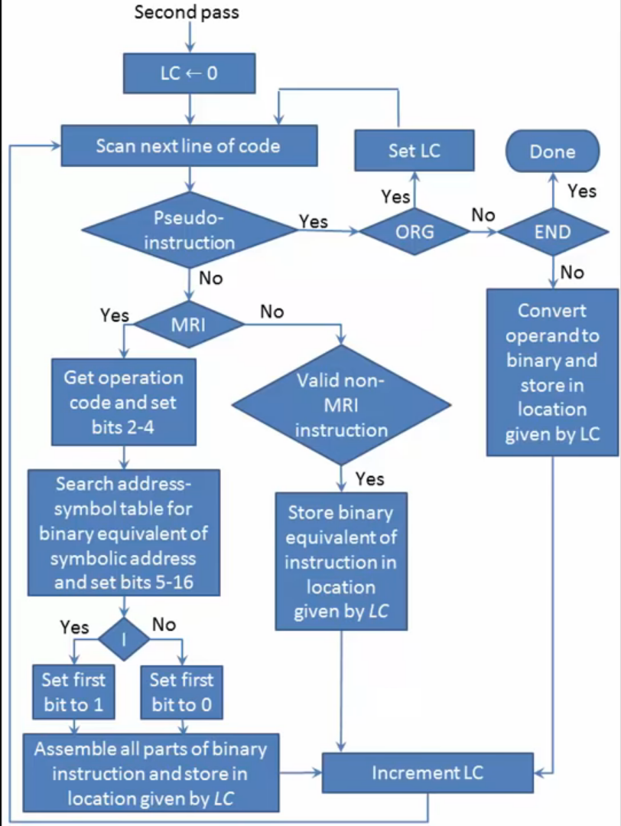
Assembler – Second pass of Assembler

Slide 31
WHY DO WE NEED A TWO-PASS ASSEMBLER?
As explained, the one-pass assembler cannot resolve forward references of data symbols.
It requires all data symbols to be defined prior to being used.
A two-pass assembler solves this dilemma by devoting one pass to exclusively resolve all (data/label) forward references and then generate object code with no hassles in the next pass.
If a data symbol depends on another and this another depends on yet another, the assembler resolved this recursively.

Slide 32
SUBROUTINE
A set of common instructions that can be used in a program many times is called a subroutine.
Each time that a subroutine is used in the main part of the program, a branch is executed to the beginning of the subroutine.
After the subroutine has been executed, a branch is made back to the main program.
A subroutine consists of a self contained sequence of instructions that carries a given task.

Slide 33
SUBROUTINE - Example
Original Program
Subroutine
 |  | ORG 100
100 |  | LDA X
101 |  | BSA SH4
102 |  | STA X
103 |  | LDA Y
104 |  | BSA SH4
105 |  | STA Y
106 |  | HLT
107 | X, | HEX 1234
108 | Y, | HEX 4321
109 | SH4, | HEX 0 | 102
10A |  | CIL
10B |  | CIL
10C |  | CIL
10D |  | CIL
10E |  | AND MSK
10F |  | BUN SH4 I
110 | MSK, | HEX FFF0
 |  | END

